Slide 1
Public Markets Update
May 2015

Slide 2
Project Background
2006 – 2008 Bar and Restaurant moratorium on ByWard Market – New zonings approved
June 2012 – Council approves visioning exercise
June 2013 – Council adopts vision and framework in PPS report for next steps of Markets Revitalization:
“A new management model is required that has the authority, operational control, and funds to support the retailing of local farm fresh food and local products.”

Slide 3
Project Background
Six main tasks:
New governance model for Public Markets
Establish strong mandate to strengthen markets
Business case to support governance group
Plan for building to support market function
New public space plan incl. building renovations
ByWard Zoning review

Slide 4
Project Schedule
Phase | Task | Timeline | Deliverable
Phase I – Project Direction | Develop and approve project charter, stakeholder plan -Stakeholder update and input | Feb. 2014 | Political and Steering committee sign off Engage PPS Project Team staffed Stakeholder relations begin
Phase II – Initial Information dissemination and gathering - Direction confirmation | ISD and PPS to commence public space feasibility and costing on range of options PPS to advance governance and business case development -Update stakeholders | March to June 2014 | - Steering committee and political sponsors get update, narrow public space options for further study and confirm governance and business case direction

Slide 5
Project Schedule
Phase | Task | Timeline | Deliverable
Phase III | - PPS creates draft report of governance and business case ISD refines public realm feasibility and costing Stakeholder update and input | Q3 2014 | Steering committee and political sponsors get update, narrow public space options for further study and confirm governance and business case recommendations
Phase IV (We are here) | Finalization of PPS report and public space concept plan and budget recommended go forward approach - Stakeholder update and input/public consultation | Q4 2014 | Steering committee, senior management, political sponsors get update and agree on final go forward plan

Slide 6
Project Schedule
Phase | Task | Timeline | Deliverable
Phase V – Staff report creation, committee and council approval | Complete final report and accompanying materials Stakeholder comments included Develop and execute external comms plan Develop and execute internal comms plan | Q1 2015 | - Approval of go forward in 2014 – 2018 Term of Council Strategic Priorities - Committee and Council approval of go forward plan

Slide 7
Governance

Slide 8
Mission
“The mission is to maximize the City’s markets as vibrant, year-round public markets for local farm produce, arts, crafts and products and people gathering places in clean, safe environments through proactive, entrepreneurial and dynamic management of the City of Ottawa’s public spaces and buildings.”

Slide 9
Goverance Scope
Stands – Layout, lease, policy
ByWard Market Building – Renos, leasing
Businesses in Parking Garage – Leasing
Marketing, financials
Special Programming
Event organization
Street Uses

Slide 10
Project Geographic Scope

Slide 11
Governance Qualities and Abilities
Focus all efforts on achieving mission
Entrepreneurial and nimble
Inclusive and collaborative
Make decisions quickly and independently
Balance business and community objectives
Apolitical in its dealings
Self sustaining financially
Surpluses for market

Slide 12
Governance Qualities and Abilities
Enter partnerships and fundraise
Be financially transparent
Be responsible to the City as Market owner
Aggressively recruit fresh food retailers
Expanding market activities and events
Improving business practices and shopping experience
Embrace change and new ideas

Slide 13
Governance Choices
Municipal Board
Status quo
New City Department
Municipal Service Corporation
External management partner

Slide 14
Governance Recommendation
Municipal Service Corporation to manage markets
City is sole shareholder, no asset transfer
Board positions BIAs, Standholders, LCA
Corporate articles set mandate to achieve mission
Council sets powers, duties, restrictions
Corp bylaws set out Council’s goals and objectives
Corp answers to Council in annual reports
Financially self sustaining as in business plan
$380g budget for creation and transition

Slide 15
Business Plan – Recommendation
Five year proforma developed
Rents and other revenues to corp.
Reserve fund to the corp.
Financial self-sustainability within three years
Deficit budgeting only when authorized by Council
% surpluses to new initiatives
%surplus to operating and capital reserves
Reserves caps set, surpluses to City
Council approves budgeting / annual reports
Detailed leasing, operations plan developed

Slide 16
Zoning – Review and Recommendation
Review
Bars, restaurants, nightclub use expanding
Zoning review, no need for changes
Evidence of non-compliance with zonings
Proactive zoning enforcement lacking
Communication gaps between BS and Bylaw
Recommendation
One-year proactive zoning compliance program
Develop good neighbour agreement
Develop patron outreach program
Close internal gaps (done)

Slide 17
Public Space- Concept Plan

Slide 18
Public Space - Concept Plan

Slide 19
ByWard Street

Slide 20
York Street Square

Slide 21
George Street Square

Slide 22
William

Slide 23
New Building - Concept Plan

Slide 24
Market Building Concept Plan

Slide 26
Options A and B

Slide 27
Option C

Slide 28
Building Concept Goals
Most return on investment
Create revenue generating second floor
Make best use of existing infrastructure in building
Allow market activities
Low risk in construction and design

Slide 29
Concept Plan – Components

Slide 30
Street Component Cost Estimates
Area 1 – Market Square -- $3.53 m
Area 2 – York West - $3.0 m
Area 3 – York East - $1.13 m
Area 4 – ByWard South - $1.3 m
Area 5 – William South - $1.12 m
Area 6 – George Street - $1.5 m
Area 7 – William North - $.33 m
Area 8 – Byward North - $. 38 m
Area 9 – Clarence Street - $1.85 m

Slide 31
Building Component Cost Estimates
400 space underground parking garage - $47.4 m
300 space underground parking garage - $38.2 m
New Building - $13.1 m + current tenants costs
ByWard Building:
Option A – $ 4.1m
Option B – $ 4.68 m
Option C – $ 9.35 m
Do nothing – nil
Concept Plan Maximum Potential Grand Total - $82 m

Slide 32
Project Recommendation
Zoning – Conduct and Report Back
Governance – Set up and transition, plan for future
Streetscaping – Develop and implement short term initiatives
Public Space – Defer major public space decisions to 2018-2022 unless funding secured term of council
Buildings – Defer investments until firm leasing and implementation plan developed (next term of council priorities)
Current Costs
$500,000 (zoning and transition)
$150,000 streetscaping

Slide 33
2015-2018 Possible Investments
If funding found:
William Street South - $1.12 m
George Street - $1.5 m
ByWard South - $1.3 m
Market Building Reno design - $800,000
Market Building Reno Implementation - $4.2 m

Slide 34
2015-2018 Public Space Plan
Existing Budget - $150,000
Experiment with low cost alternatives (temporary street closures, pedestrian pavement markings etc.)
Review stand layout, customer flows, pedestrian flow
Explore new layouts with input from stakeholders
Develop plan for short-term investments in 2016 for 2017
Further refine concept plan based on experience

Slide 35
Sample Low Cost Initiatives

Slide 36
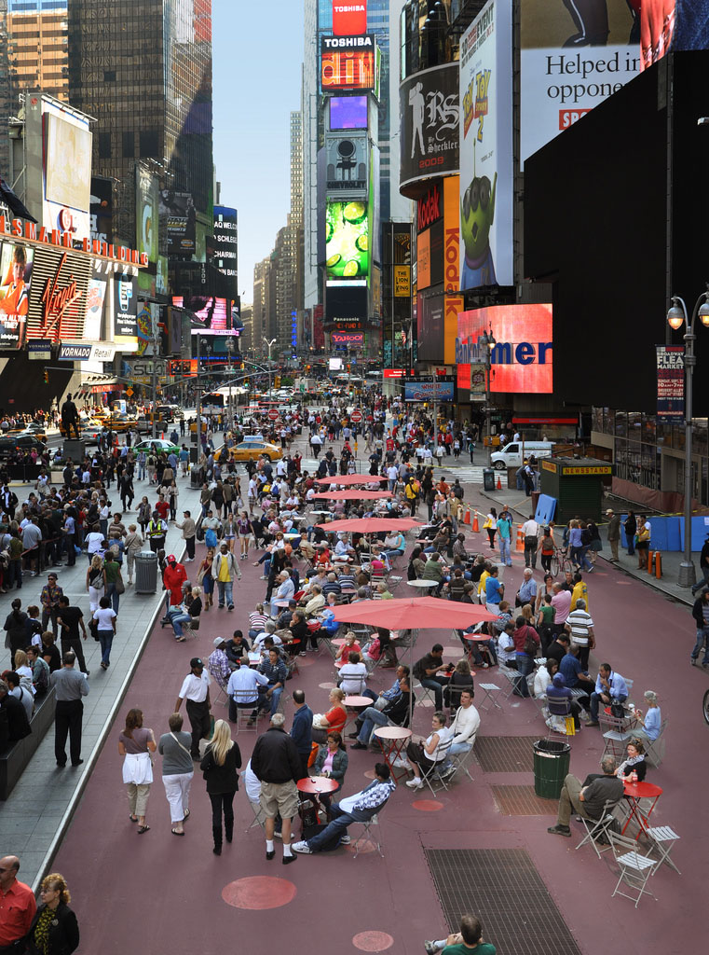
Sample Low Cost Initiatives

Slide 37
Sample Low Cost Initiatives

Slide 38
Temporary Street Closure Example

Slide 39
2015 to 2018 Building Plan Process
No major undertakings for two years
Retail and marketing study to inform leasing decisions
Consult with stakeholders (current lease holders, BIA etc.)
Develop leasing plan
Work with current lease holders on transition if needed
Further refine the ByWard Market building renovation plan to reflect new direction
Develop building solid building renovation plan
Budget request for next term of Council priority setting process

Slide 40
Next Steps – Current Phase
SI submission (completed)
June/July strategic initiatives process
Finalization of PPS business case and governance report (underway)
Refine public space concept plan and budget (completed)
Finalize Draft recommendations (pending)
Public consultation and stakeholder input on Recommended Plan (later in 2015)
Draft report to Committee and Council
Committee and Council Q3 2015

Slide 41
Questions/Input

